Slide 1
Project title
Maximum 15 slides
Layout can be customised
Add subtitle

Slide 2
Proposed structure
The urban mobility challenge your are addressing
Your proposed innovative solution(s)
  Key novelties and competitive advantages compared to existing solutions, maturity level and key developments to be achieved as a result of the project)
  Include Innovation maturity radar chart (see instructions in the following slides)
Market, business model and commercialisation potential
Project workplan, including proposed demos, their ambition and expected impact/metrics
Overview of project budget and proposed financial sustainability mechanism (FSM)
The project team
Closing statement on why EIT Urban Mobility should support this project

Slide 3
Innovation Maturity Radar
To help understand your innovation’s development stage, please complete the Innovation Maturity Radar self-assessment for each proposed solution.
Instructions:
Score each dimension from 1 (not started) to 5 (fully mature) using the criteria below.
Plot your scores in a radar chart
Add a short justification (1–2 lines) per dimension explaining your score. This should be aligned with the information included in your application form
Scoring criteria
Dimension | Description | Scoring guidance (0-5)
Technology readiness | Maturity level of the core technology or technical solution. | 1: Idea only; 2: Early development or lab-tested; 3: Field tested 4: Operational pilot; 5: Fully validated and scalable
IP protection | Level of protection of intellectual property. | 1: No IP activity; 2: Initial idea or trade secret; 3: IP filing in progress; 4: Patent pending or copyright filed; 5: IP secured/granted
Commercial readiness | Market traction, business model clarity, and customer validation. | 1: Concept only; 2: Market research done; 3: Pilots or early sales 4: Commercial activity started; 5: Paying customers and scaling
Regulatory readiness | Compliance with regulatory requirements in the target market(s). | 1: No assessment; 2: Under exploration; 3: Some engagement or partial compliance; 4: Regulatory approval in progress; 5: Fully compliant

Slide 4
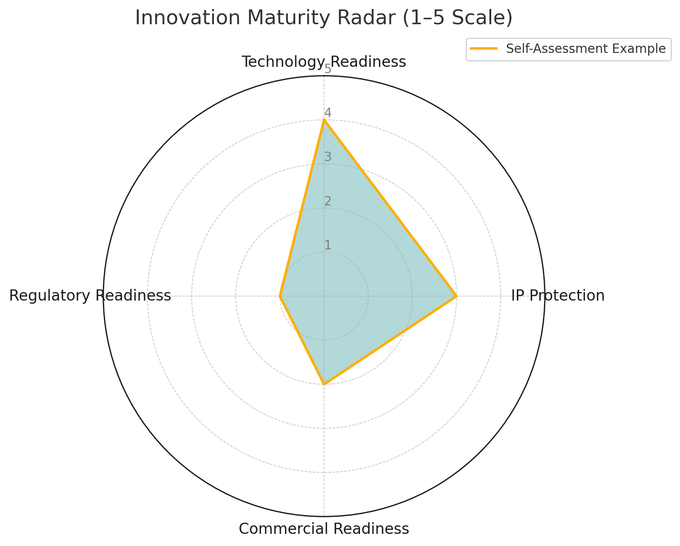
Innovation Maturity Radar
Example
Technology Readiness: 4
Prototype tested in a real-world urban setting; integration with fleet system underway.
IP Protection: 3
Patent application submitted; trademark filed for brand identity.
Commercial Readiness: 2
Customer interviews completed; pilot agreements under discussion.
Regulatory Readiness: 1
Still assessing applicable certifications for urban deployment.

